Slide 1

FPGA Acceleration of DNA Sequence Mapping Team: DNA Mappers
Aditya Narayan Aastha ANAND G SIVA PERUMAL
SARTHAK JAGETIA ANAND SHIVALKAR

Slide 2
Background and Motivation
High Level Diagram and Specifications
Functional Description of Blocks
Results and Analysis
Successes and Failures
Conclusion and Future Work

Slide 3
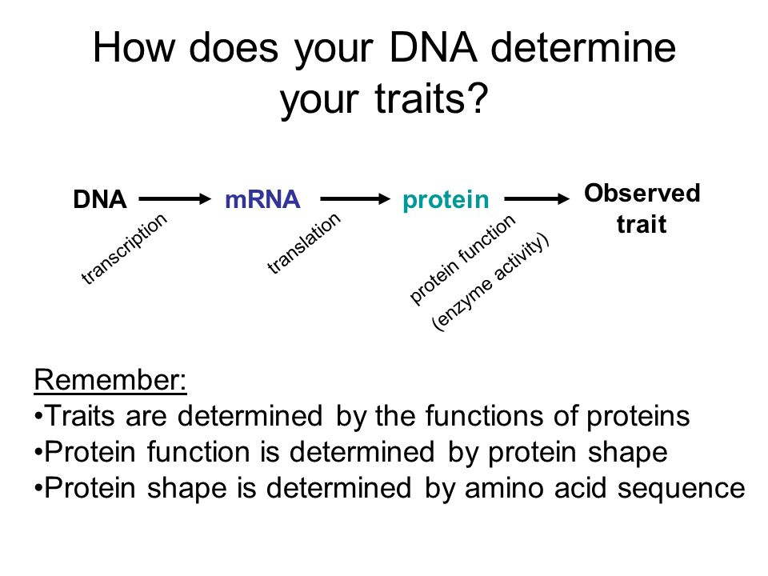
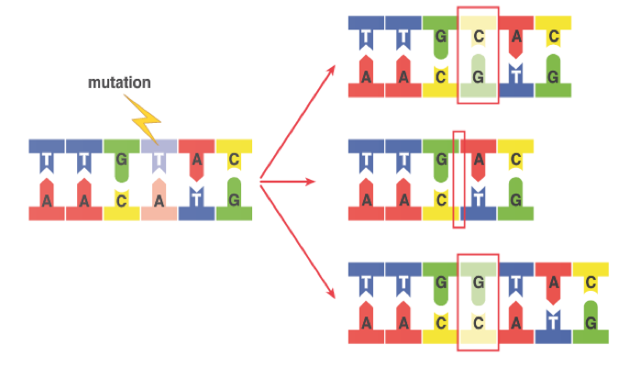
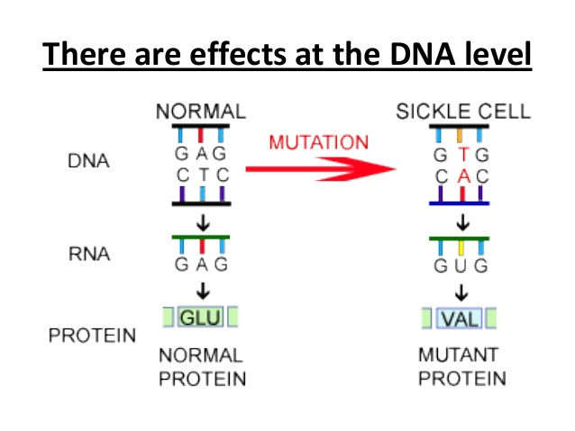
Background
Central dogma of molecular biology
Substitution
Sequence Mapping
Deletion
Insertion

Slide 4
DNA Sequence Mapping on FPGA
Short read mapping has traditionally been performed by software tools such as Bowtie, BWA , MAQ and BFAST running on a cluster of processors.
Huge Computational burden due to comparison of >1 billion short reads against a very long reference genome
Require 30-50 CPU days for complete mapping and alignment
Can be significantly accelerated by the use of FPGAs and GPUs
Olson, Corey B., et al. "Hardware acceleration of short read mapping." Field-Programmable Custom Computing Machines (FCCM), 2012 IEEE 20th Annual International Symposium on. IEEE, 2012.

Slide 5

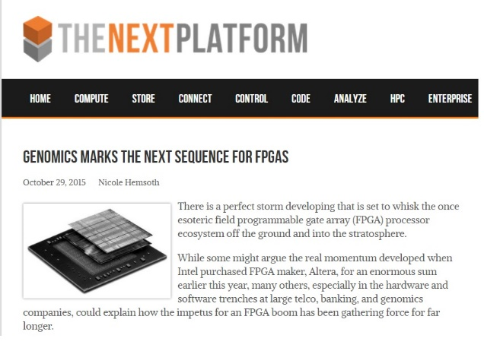


Scope and Motivation

Slide 6
Background and Motivation
High Level Diagram and Specifications
Functional Description of Blocks
Results and Analysis
Successes and Failures
Conclusion and Future Work

Slide 7
Initial High Level Block Diagram
.
Zedboard
Short Read
Index Finder
DDR Memory (Index and Reference)
FIFO
Reference Lookup
S-W
…
S-W
Aligned Reads
Score Tracker

Slide 8
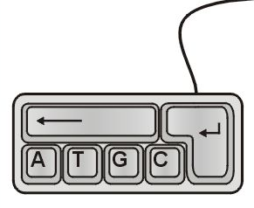
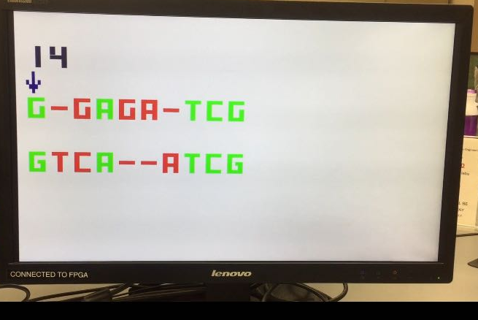
Final High Level Block Diagram
Load Reference Sequence
Indexing Block
FIFO
Smith Waterman PreProcessor
VGA Controller
Smith Waterman Scoreboard
Systolic Array
Traceback

Slide 9
Background and Motivation
High Level Diagram and Specifications
Functional Description of Blocks
Results and Analysis
Successes and Failures
Conclusion and Future Work

Slide 10
Indexing
Break down reference sequence into seeds (4 characters long) and store them in separate CAL tables
Compare seeds from the input short reads with the reference seeds
Identify all the indexes in the reference sequence where the short read can map with a high likelihood
TGTCCAGTATGCCTCCAGTAGATCGCATTCGAGAATCCGA
TGACCAGT
GCATAAGA
Index=0
Index=11
Index=24

Slide 11
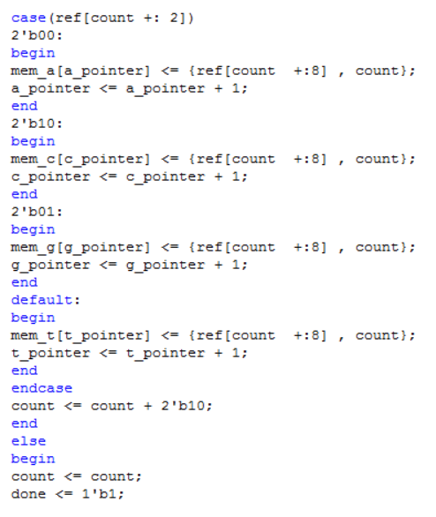
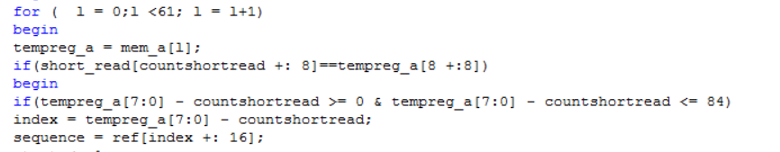
Verilog Code Implementation

Slide 12
Smith Waterman Pre-Processor
Generate sequence 1 from the reference sequence using the index
Sequence 2 is the input short read
Store the sequences 1 and 2 in a FIFO until Smith Waterman is ready to compute :
Smith Waterman takes n² clock cycles to compute
Indexing provides output every clock cycle until done

Slide 13
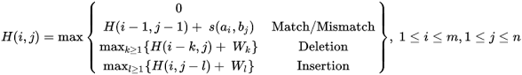
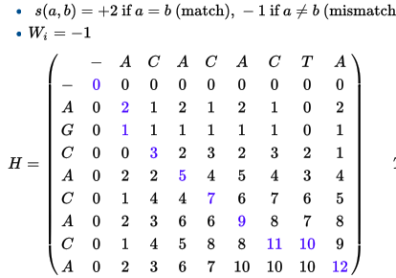
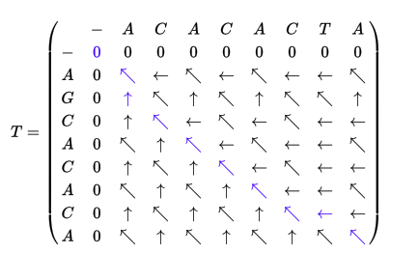
Local Sequence Alignment – Smith Waterman Algorithm
Why Smith Waterman?
Commonly used for comparison of 2 strings
The fully gapped algorithm provides accurate scoring, even in the presence of indels
Search space is quadratic as opposed to exponential search space of other algorithms
Can be implemented efficiently using 2D systolic arrays

Slide 14
Smith Waterman Implementation using Systolic Arrays
A
T
G
C
A
PE
PE
PE
PE
T
PE
PE
PE
PE
G
PE
PE
PE
PE
C
PE
PE
PE
PE

Slide 15
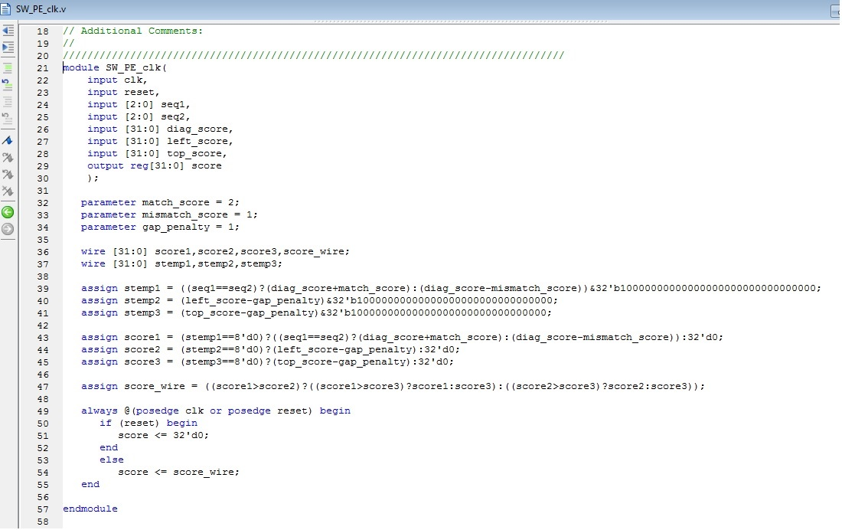
Smith Waterman Processing Element
Compute current score from
Diagonal score
Top score
Left score
Find maximum of the 3 scores to assign to the current element
Combinational block executing every clock

Slide 16
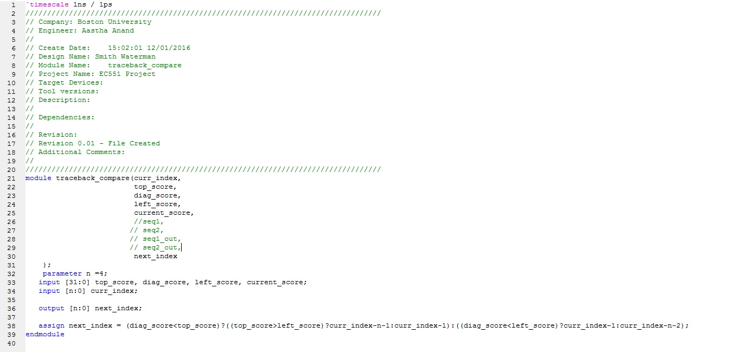
Traceback Element
To output the character of sequence 1 and sequence 2 at (i,j)
Diagonal value maximum : seq1 and seq2 match or SNP
Left value maximum : Deletion in seq2
Top value maximum : Insertion in seq2

Slide 17
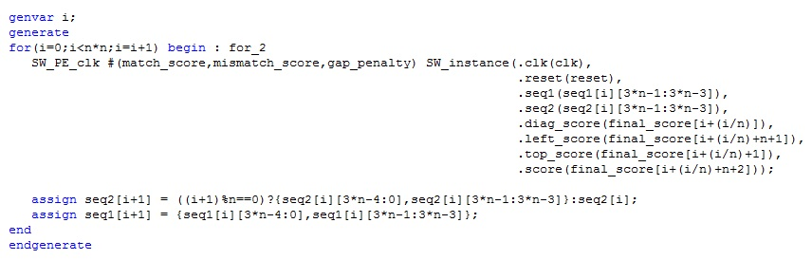
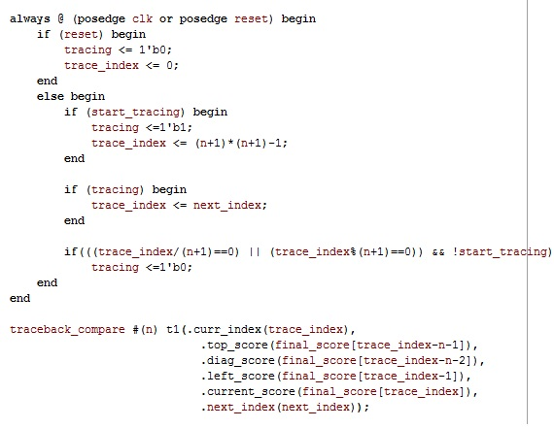
Verilog Implementation of Smith Waterman

Slide 18
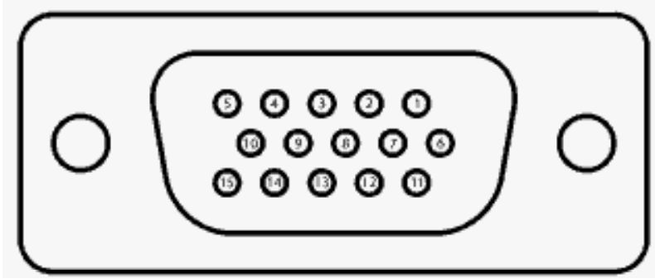
VGA Interfacing
Zedboard allows 12 bit colour output through VGA connector
So VGA_R, VGA_G, VGA_B all 4 bits each
Other pins used are Horizantal sync and Vertical sync

Slide 19
I/O Interfacing & challenges
Serial Inputs from Smith Waterman block are displayed on the computer screen via VGA display cable
Dynamically displaying all the sequences from the previous module along with the index as shown.
Not easy because had to code for letters ‘A’, ‘G’, ‘C’, ‘T’ & ‘-’ .
So coding for 15 characters in one sequence and 2 sequences in total!
That’s 30 characters being displayed dynamically!
Displaying the numbers dynamically by coding for digits ‘0 – 9’ for 2 digit index given by the Smith Waterman algorithm
Too many if-else loop created too much constraints while synthesizing the code and it took nearly 30-40 mins for it to build.

Slide 20
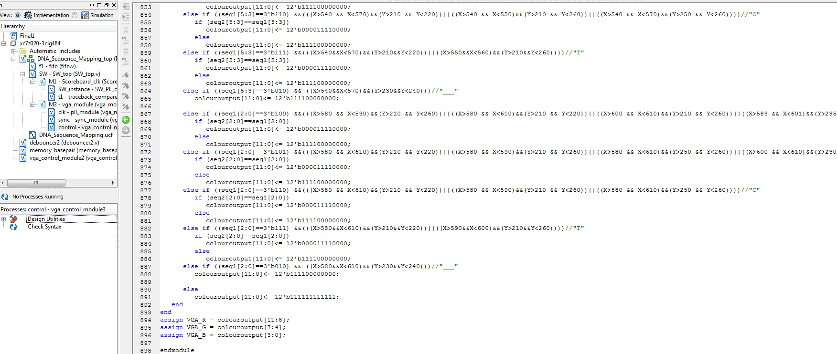
Verilog Implementation of VGA Controller

Slide 21
Background and Motivation
High Level Diagram and Specifications
Functional Description of Blocks
Results and Analysis
Successes and Failures
Conclusion and Future Work

Slide 22
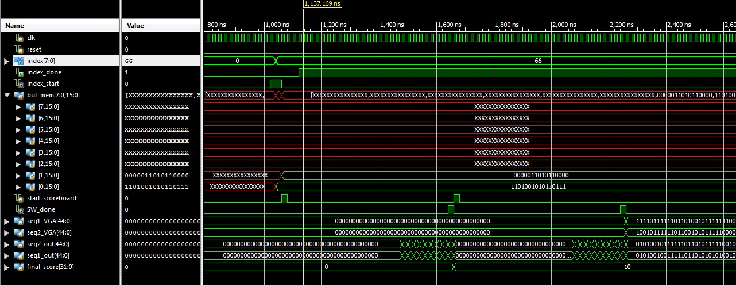

Slide 23
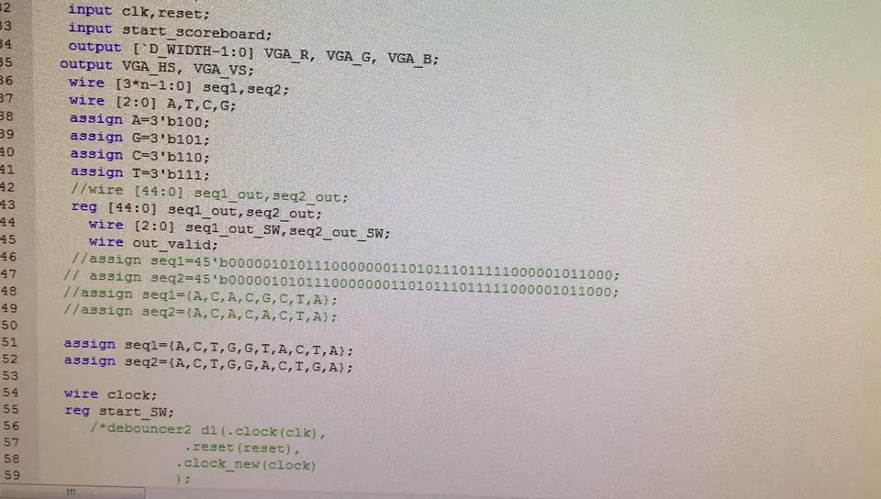
Demo Movie 1 – Local Sequence Alignment
Seq1 – ACTGGTACTA
Seq2 – ACTGGACTGA
Objective – Find local sequence alignment of the 2 sequences

Slide 24
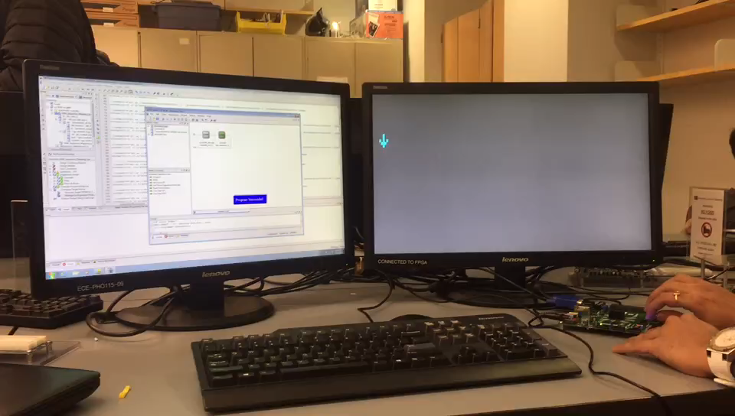
Demo Movie 2
Ref Sequence: Length 50
TGTCCAGTATGCCTGACGTCGATCGCATTCGAGAATCCGAATAAAGTATT
Short Reads
TGGTAAAT
AGTCCGTA
CGTCGATC
Objective – Find the best match of the short reads in the reference sequence with substitution, insertions and deletions

Slide 25
Background and Motivation
High Level Diagram and Specifications
Functional Description of Blocks
Results and Analysis
Successes and Failures
Conclusion and Future Work

Slide 26
Successes
Performed Local Alignment of 2 sequences using Smith Waterman Algorithm
Implementation of CAL table for seeding the reference indexes
VGA Interfacing for output display
Timing Accurate Implementation of Smith Waterman Algorithm
Working Prototype for performing DNA Sequence Mapping – Not that efficient

Slide 27
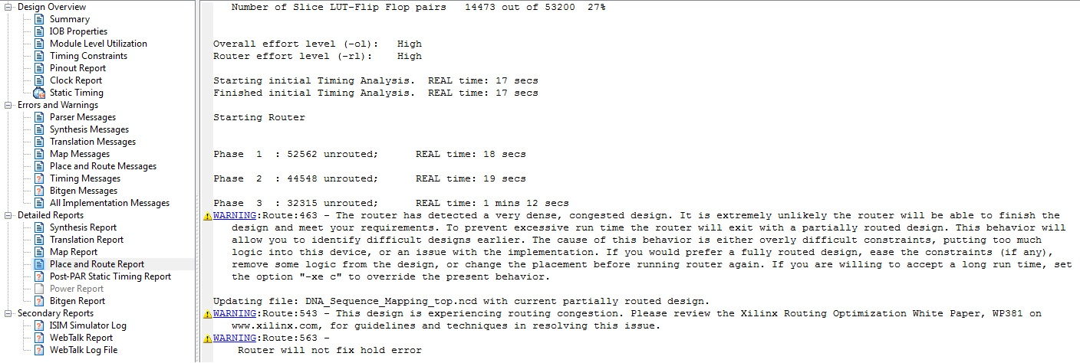
Failures
Integration of Indexing and Smith Waterman Block -> Timing and Routing Error
*Paste the routing congestion error*
Probably due to combinational implementation of Indexing

Slide 28
Failures
Spent a lot of time on getting user input through UART (Putty)
Tried Parallel Smith Waterman Implementation, but couldn’t integrate with the top module
Long Sequences takes a long time to build, (place & route) -> might need some compression algorithm
Takes a long time for Place & Route (~45mins) -> Design not that efficient

Slide 29
Work Allocation
High Level Block Diagram and Functional Specification – Everyone
Indexing Block – Siva, Anand
Smith Waterman Pre Processor – Anand
Smith Waterman Block – Aditya, Aastha
VGA Interfacing for I/O – Sarthak, Aastha, Aditya
Overall Integration – Aditya, Siva, Sarthak

Slide 30
Background and Motivation
High Level Diagram and Specifications
Functional Description of Blocks
Results and Analysis
Successes and Failures
Conclusion and Future Work

Slide 31
Future Work
Parallel Smith Waterman algorithm
Test with longer short reads and references
Store Reference sequence in DRAM and implement a DRAM controller
Burrows-Wheeler Transform for data compression to solve the short read mapping problem

Slide 32
References
Olson, Corey B., et al. "Hardware acceleration of short read mapping." Field-Programmable Custom Computing Machines (FCCM), 2012 IEEE 20th Annual International Symposium on. IEEE, 2012.
Lopresti, Daniel P. "P-NAC: A systolic array for comparing nucleic acid sequences." Computer 20.7 (1987): 98-99.
Herbordt, Martin C., et al. "Single pass streaming BLAST on FPGAs." Parallel computing 33.10 (2007): 741-756.
https://en.wikipedia.org/wiki/Smith%E2%80%93Waterman_algorithm
Vermij, E. P. Genetic sequence alignment on a supercomputing platform. Diss. TU Delft, Delft University of Technology, 2011.
Special Thanks to Prof. Martin Herbordt and Prof. Wenchao Li for inputs

Slide 33


